Slide 1

CYBER edge
CYBER edge
Group 4
Code - https://github.com/ParadoxPD/cyber-edge

Slide 2

The team
Group 4
PRIYANSHU DAS
ASHISH SRIVASTAVA
RAKESH CHOUDHARY
HARISH PRAKASH SINGH

Slide 3

Agenda
Problem Statement
Proposed Solution
Technical Details
Demo
Further Scope
Q&A

Slide 4
Problem Statement
Objective
Managing the security posture of multiple servers and virtual machines (VMs) in an enterprise environment is challenging. Administrators often struggle to keep track of security vulnerabilities, outdated software, and unpatched systems.
Additionally, conducting compliance checks using OpenSCAP and CIS benchmarks requires manual intervention, making it inefficient and error-prone. There is a need for an automated, centralized, and user-friendly solution that provides real-time security insights and compliance reports for all managed servers.

Slide 5

Proposed solution
Let’s Dive In

Slide 6
solution
The Security-Centric Server & VM Management Tool is a web-based platform that enables administrators to monitor and enforce security best practices across multiple servers. It consists of the following components:
React-based Web Dashboard
Host Agent (Backend Server)
Guest Agent (Client Script)

Slide 7
Feature Breakdown
📝 OpenSCAP Hardening Reports
Runs compliance scans and sends results to the host.
🔓 Open Ports Scan
Lists open network ports.
📦 Patching Status
Checks for available updates.
🦠 Antivirus Status
Verifies AV software status.
🔐 Encryption Check
Identifies disk encryption status.
🛠️ Third-Party Software Inventory
Lists installed packages.

Slide 8
Key benefits
✅ Centralized Security Management: Monitor multiple servers from a single dashboard.
✅ Automated Compliance Reporting: Uses OpenSCAP with CIS benchmarks for security hardening.
✅ Real-time Insights: Helps administrators quickly identify and address vulnerabilities.
✅ User-friendly Interface: Provides a clean and intuitive UI for easy navigation.
✅ Lightweight & Efficient: Uses SQLite, React, and Node.js for a scalable and low-resource solution.

Slide 9
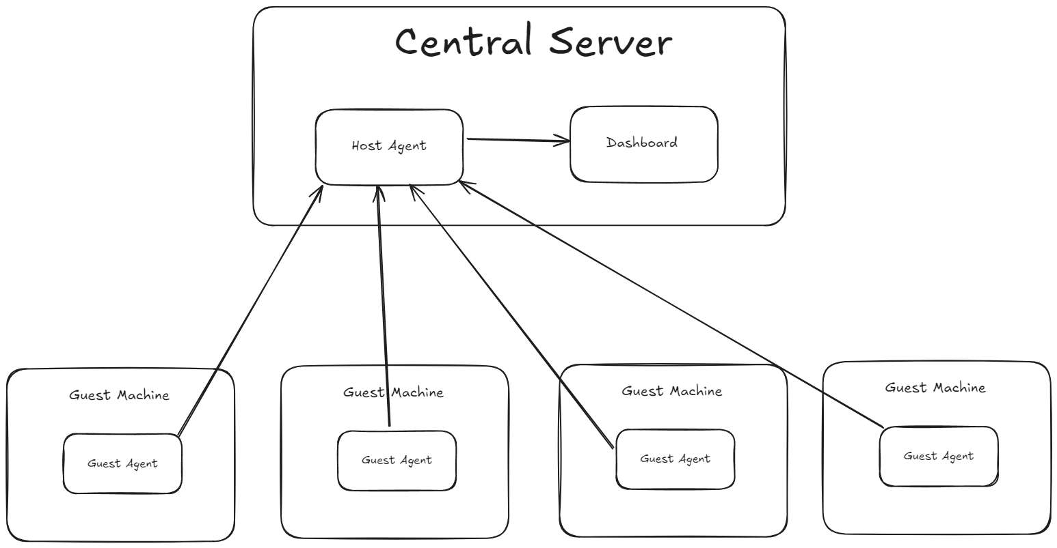
High level design

Slide 10

Technical details

Slide 11
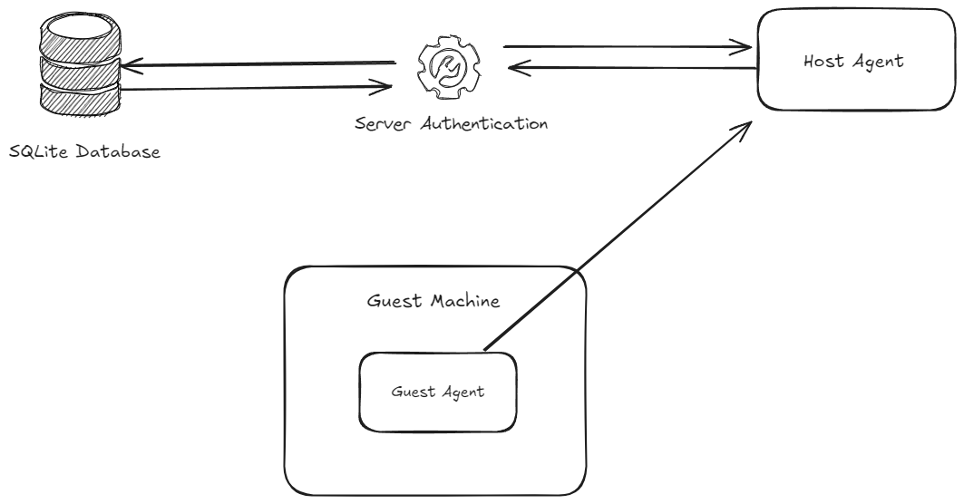
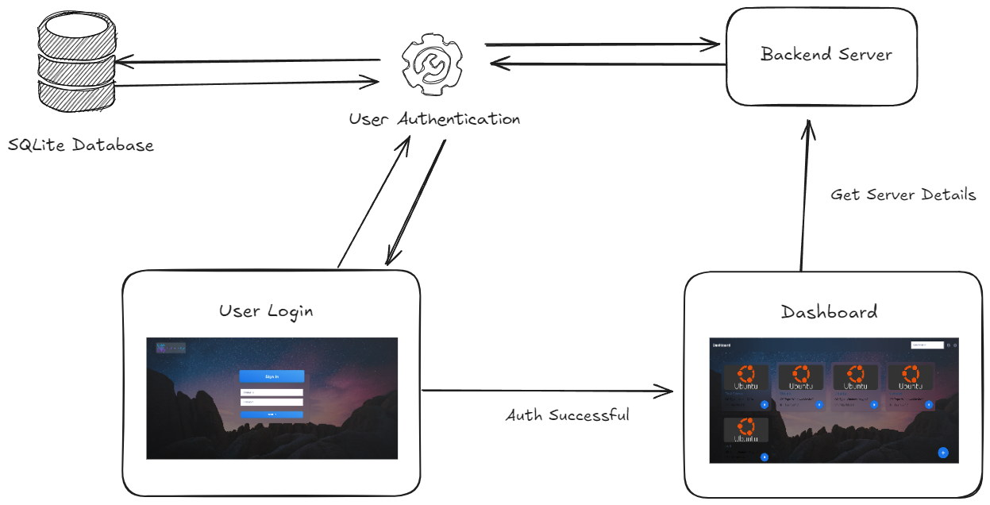
System design

Slide 12
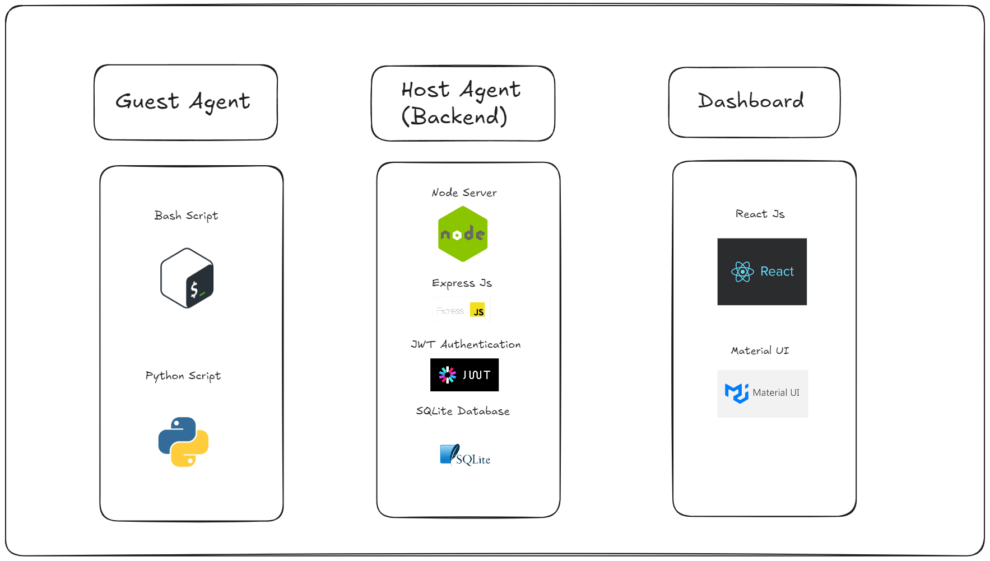
Tech stack

Slide 13
demo

Slide 14
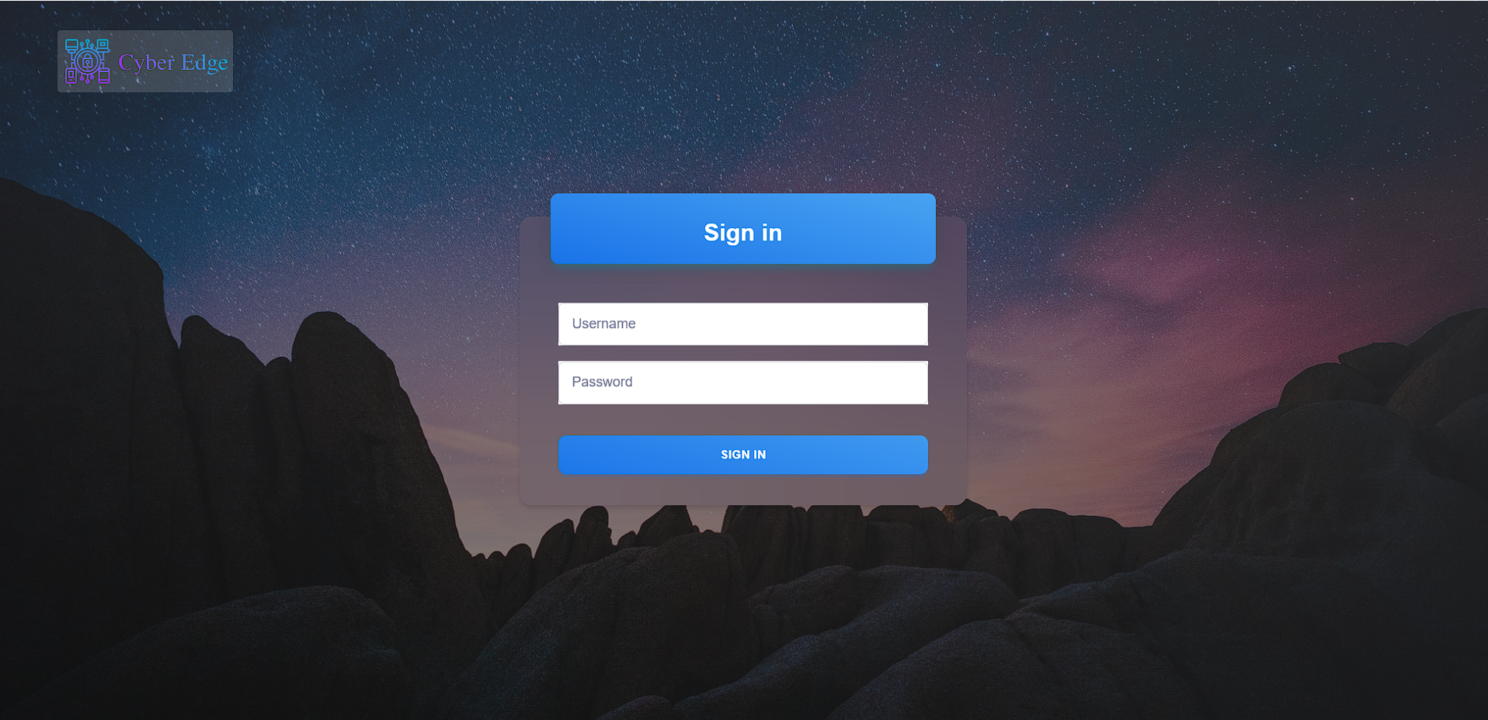
login page

Slide 15
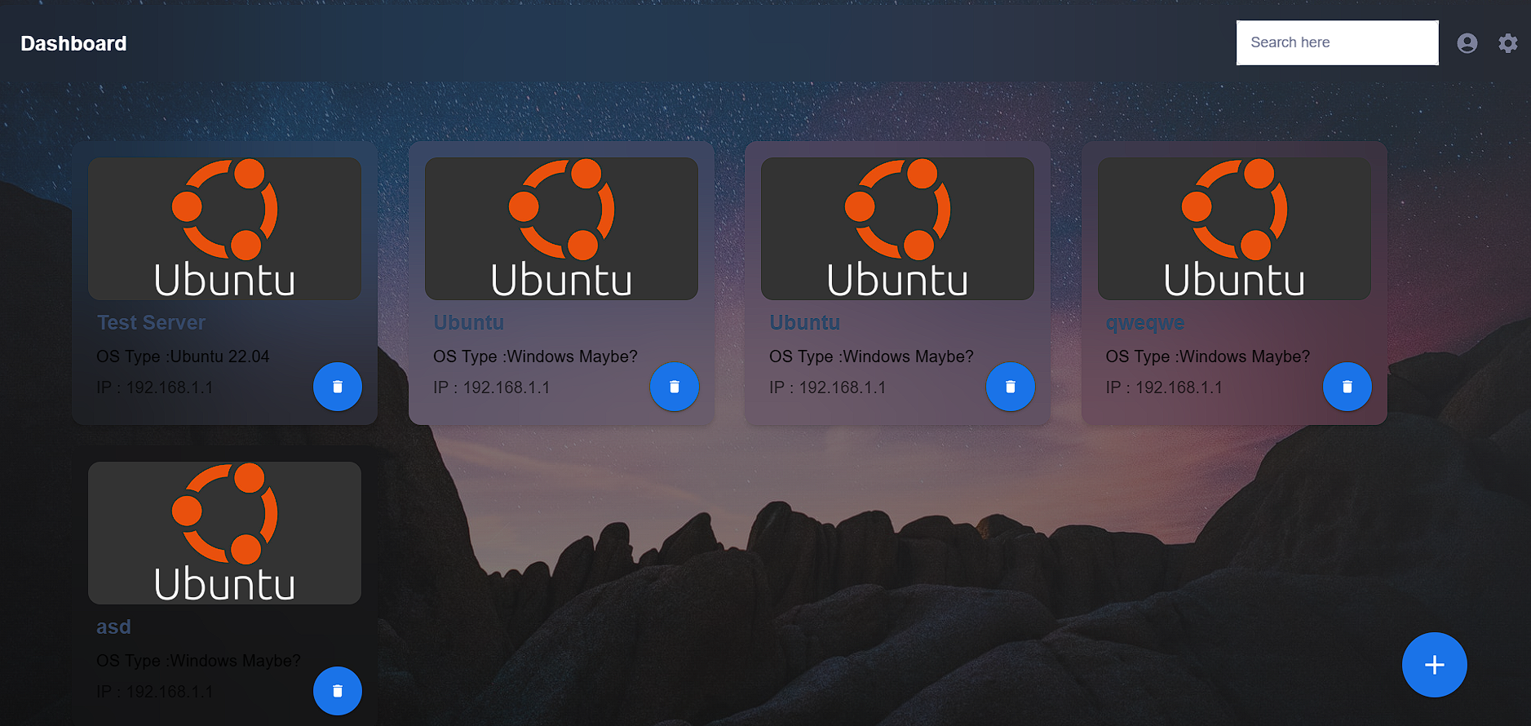
Dashboard

Slide 16
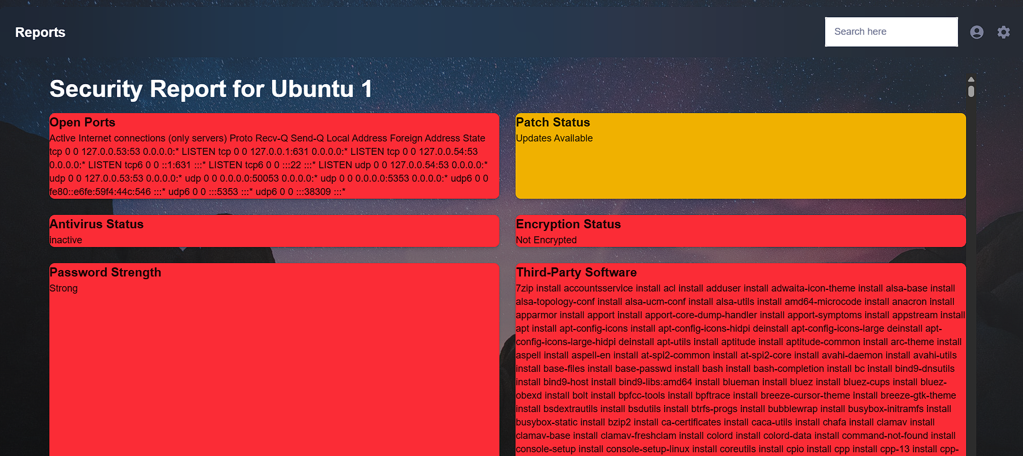
reports

Slide 17
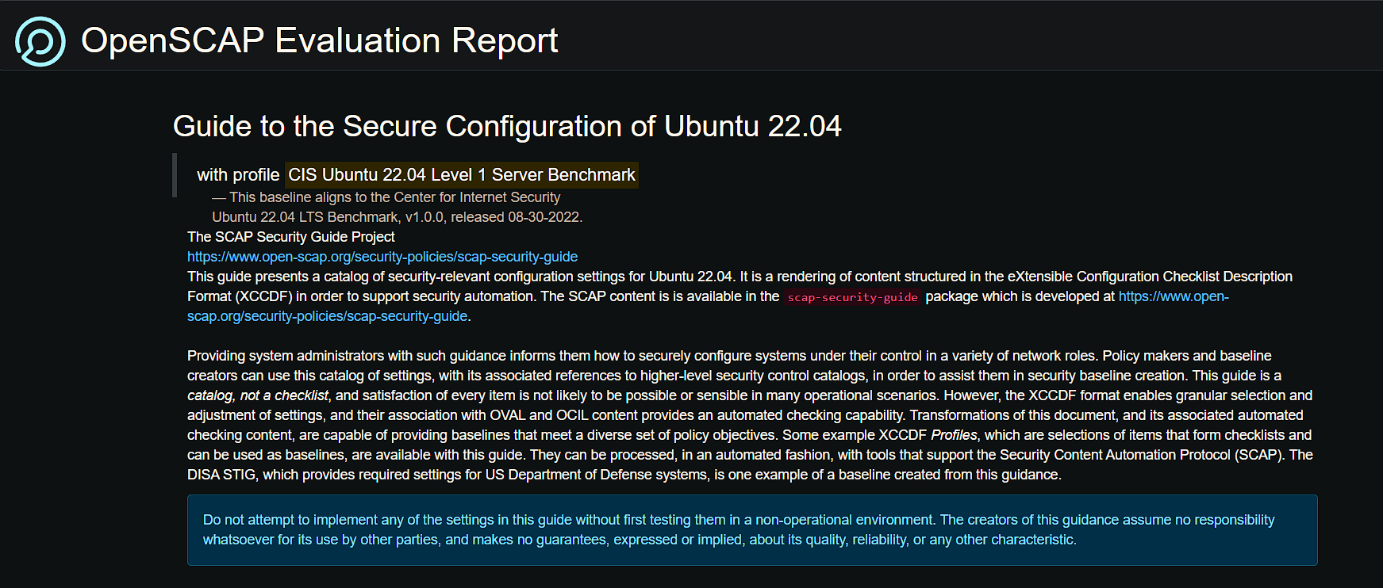
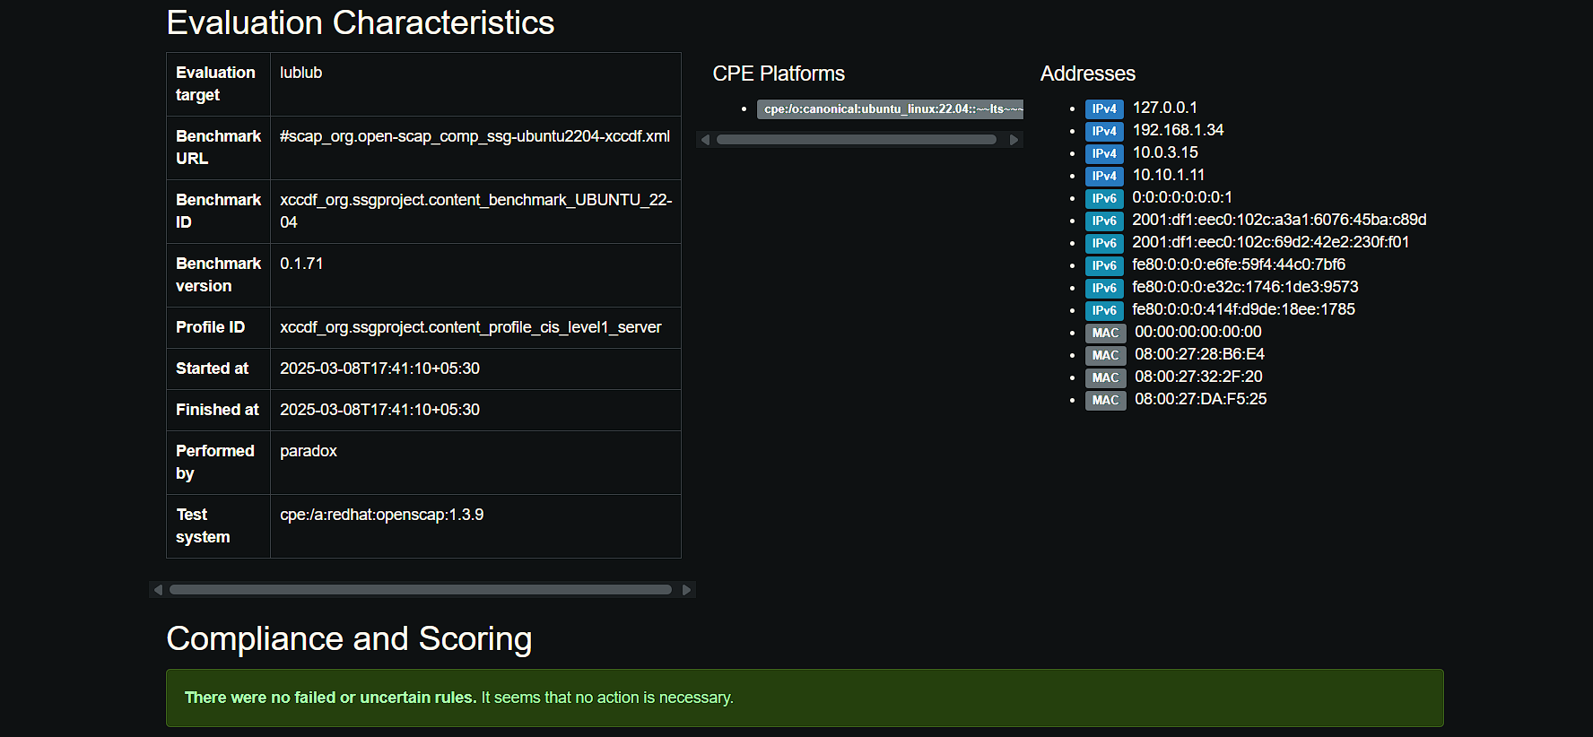
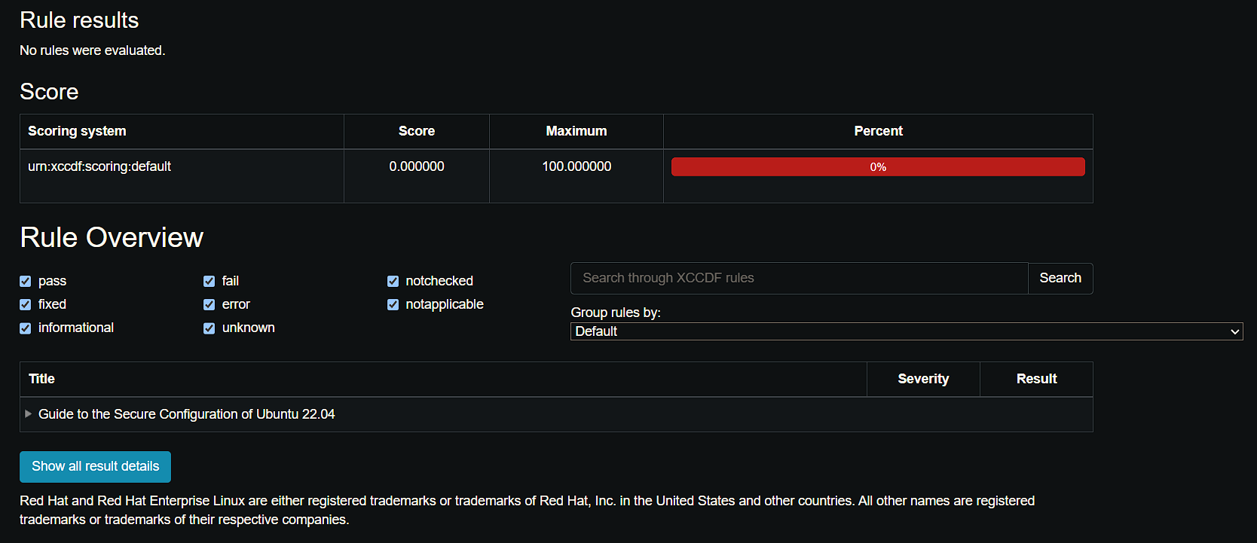
OpenScap CIS benchmarck report

Slide 18
Future scope

Slide 19

Scheduled Scans & Alerts
More In-Depth Scanning and Report Generation
System Telemetry and Graphical Data Visualization
Role-based access for teams.
Email/Slack Notifications
Data Aggregation Enhancements

Slide 20
Any Questions?

Slide 21
THANK YOU
CYBER EDGE

